Slide 1
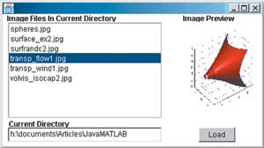
TCSS 360, Spring 2005
Lecture Notes
Model-View-Controller paradigm;
Observer pattern;
Creating Graphical User Interfaces in Java/Swing
Relevant Reading:
UML Distilled, Third Edition, Chapter 4
M. Fowler

Slide 2
Outline
what we can do:
creating a GUI using Java and Swing
  Java graphical component hierarchy
  layout and positioning of graphical components in a GUI
  Java's event-driven model: action events
  GUI builder software, in brief
what we should do:
reminder about MVC (model-view-controller) paradigm
Observer pattern

Slide 3
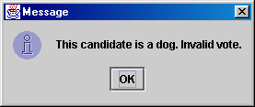
Simplest GUI programming:
JOptionPane
An option pane is a simple dialog box for graphical input/output
advantages:
  simple
  flexible (in some ways)
  looks better than the black box of death
disadvantages:
  created with static methods;
  not very object-oriented
  not very powerful (just simple dialog boxes)

Slide 4
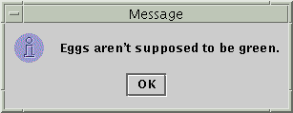

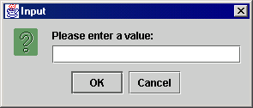
Types of JOptionPanes
public static void showMessageDialog(
Component parent, Object message)
Displays a message on a dialog
with an OK button.
public static int showConfirmDialog(
Component parent, Object message)
Displays a message and list of
choices Yes, No, Cancel
public static String showInputDialog(
Component parent, Object message)
Displays a message and text
field for input, and returns the
value entered as a String.

Slide 5
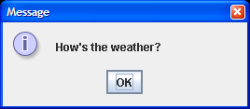
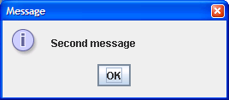
JOptionPane examples 1
showMessageDialog analogous to System.out.println for displaying a simple message
import javax.swing.*;
class MessageDialogExample {
public static void main(String[] args) {
JOptionPane.showMessageDialog(null,
"How's the weather?");
JOptionPane.showMessageDialog(null,
"Second message");
}
}

Slide 6
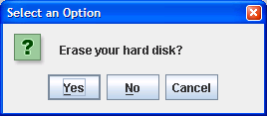
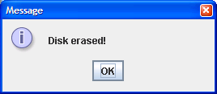
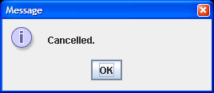
JOptionPane examples 2
showConfirmDialog analogous to a System.out.print that prints a question, then reading an input value from the user (can only be one of the provided choices)
import javax.swing.*;
class ConfirmDialogExample {
public static void main(String[] args) {
int choice = JOptionPane.showConfirmDialog(null,
"Erase your hard disk?");
if (choice == JOptionPane.YES_OPTION) {
JOptionPane.showMessageDialog(null, "Disk erased!");
} else {
JOptionPane.showMessageDialog(null, "Cancelled.");
}
}
}

Slide 7
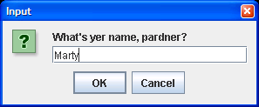
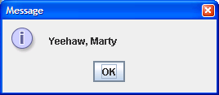
JOptionPane examples 3
showInputDialog analogous to a System.out.print that prints a question, then reading an input value from the user (can be any value)
import javax.swing.*;
class InputDialogExample {
public static void main(String[] args) {
String name = JOptionPane.showInputDialog(null,
"What's yer name, pardner?");
JOptionPane.showMessageDialog(null, "Yeehaw, " + name);
}
}

Slide 8

Onscreen GUI elements
windows: actual first-class citizens of desktop; also called top-level containers
examples: frame, dialog box
components: GUI widgets
examples: button, text box, label
containers: logical grouping for components
example: panel

Slide 9
Java GUI: AWT and Swing
Sun's initial idea: create a set of classes/methods that can be used to write a multi-platform GUI (Abstract Windowing Toolkit, or AWT)
  problem: not powerful enough; limited; a bit clunky to use
Second edition (JDK v1.2): Swing
  a newer library written from the ground up that allows much more powerful graphics and GUI construction
Drawback: Both exist in Java now; easy to get them mixed up; still have to use both sometimes!

Slide 10
Swing component hierarchy
java.lang.Object
+--java.awt.Component
+--java.awt.Container
|
+--javax.swing.JComponent
| +--javax.swing.JButton
| +--javax.swing.JLabel
| +--javax.swing.JMenuBar
| +--javax.swing.JOptionPane
| +--javax.swing.JPanel
| +--javax.swing.JTextArea
| +--javax.swing.JTextField
|
+--java.awt.Window
+--java.awt.Frame
+--javax.swing.JFrame
import java.awt.*;
import javax.swing.*;

Slide 11
Methods of all Swing components
public int getWidth()
public int getHeight()
Allow access to the component's current width and height in pixels.
public boolean isEnabled()
Returns whether the component is enabled (can be interacted with).
public boolean isVisible()
Returns whether the component is visible (can be seen on the screen).

Slide 12
More JComponent methods
public void setBackground(Color c)
Sets the background color of the component to be the given color.
public void setFont(Font f)
Sets the font of the text on the given component to be the given font.
public void setEnabled(boolean b)
Sets whether the component is enabled (can be interacted with).
public void setVisible(boolean b)
Sets whether the component is visible (can be seen on the screen). Set to true to show the component, or set to false to hide the component.

Slide 13
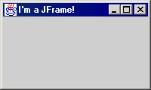
JFrame
A frame is a graphical window that can
be used to hold other components
public JFrame() or public JFrame(String title)
Creates a frame with an optional title.
public void setTitle(String text)
Puts the given text in the frame’s title bar.
public void setDefaultCloseOperation(int op)
Makes the frame perform the given action when it closes. Common value: JFrame.EXIT_ON_CLOSE
public void add(Component comp)
Places the given component or container inside the frame.
  How would we add more than one component to the frame?
public void pack()
Resizes the frame to fit the components inside it.
NOTE: Call setVisible(true) to make a frame appear on the screen after creating it.

Slide 14
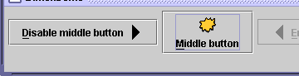
JButton, JLabel
The most common component—
a button is a clickable onscreen
region that the user interacts with
to perform a single command
A text label is simply a string of text
displayed on screen in a graphical
program. Labels often give infor-
mation or describe other components
public JButton(String text)
public JLabel(String text)
Creates a new button / label with the given string as its text.
public String getText()
Returns the text showing on the button / label.
public void setText(String text)
Sets button / label's text to be the given string.

Slide 15
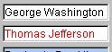

JTextField, JTextArea
A text field is like a label, except that the text
in it can be edited and modified by the user.
Text fields are commonly used for user input,
where the user types information in the field
and the program reads it
A text area is a multi-line text field
public JTextField(int columns)
public JTextArea(int lines, int columns)
Creates a new text field that is the given number of columns (letters) wide.
public String getText()
Returns the text currently in the field.
public void setText(String text)
Sets field's text to be the given string.

Slide 16
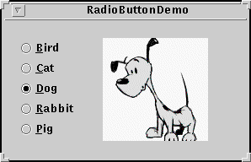
JCheckBox, JRadioButton
A check box is a toggleable button with two states:
checked and unchecked
A radio button is a button that can be selected; usually part of a group of mutually-exclusive radio buttons (1 selectable at a time)
public JCheckBox / JRadioButton(String text)
public JCheckBox(String text, boolean isChecked)
Creates checked/unchecked check box with given text.
public boolean isSelected()
Returns true if check box is checked.
public void setSelected(boolean selected)
Sets box to be checked/unchecked.

Slide 17
ButtonGroup
A logical group of radio buttons that ensures
that only one is selected at a time
public ButtonGroup()
public void add(JRadioButton button)
The ButtonGroup is not a graphical component, just a logical group; the RadioButtons themselves are added to the container, not the ButtonGroup

Slide 18

Icon/ImageIcon
Allows you to put a picture on a button, label or other component
public class ImageIcon implements Icon
  public ImageIcon(String filename)
  public ImageIcon(URL address)
in JButton, JRadioButton, JCheckBox, JLabel, etc...
  constructor that takes an Icon
  public void setIcon(Icon)
  public void setSelectedIcon(Icon)
  public void setRolloverIcon(Icon)

Slide 19

JScrollPane
A special container that holds a component, using scrollbars to allow that component to be seen
public JScrollPane(Component comp)
Wraps the given component with scrollbars.
After constructing the scroll pane, add the scroll pane to the container, not the original component.
contentPane.add(new JScrollPane(textarea),
BorderLayout.CENTER);

Slide 20
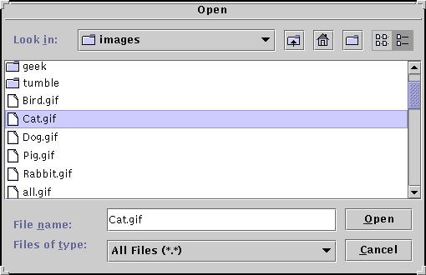
JFileChooser
A special dialog box that
allows the user to select
one or more files/folders
public JFileChooser()
public JFileChooser(String currentDir)
public int showOpenDialog(Component parent)
public int showSaveDialog(Component parent)
public File getSelectedFile()
public static int APPROVE_OPTION, CANCEL_OPTION
Possible result values from showXxxDialog(..).
JFileChooser chooser = new JFileChooser();
int result = chooser.showSaveDialog(this);
if (result == JFileChooser.APPROVE_OPTION)
this.saveData(chooser.getSelectedFile().getName());

Slide 21
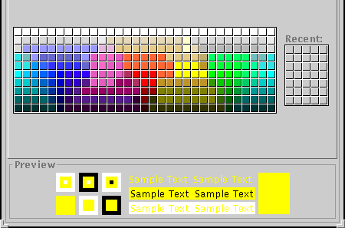
JColorChooser
Another special dialog that
lets the user pick from a
palette of colors
public JColorChooser()
public JColorChooser(Color initial)
public Color showDialog(Component parent,
String title, Color initialColor)
  returns null if user chose Cancel option

Slide 22

JMenuBar
The top-level container that holds menus; can be attached to a frame
public JMenuBar()
public void add(JMenu menu)
Usage: in JFrame, the following method exists:
  public void setJMenuBar(JMenuBar bar)

Slide 23


JMenu
A menu to hold menu items; menus can contain other menus (Composite)
public JMenu(String text)
public void add(JMenuItem item)
public void addSeparator()
public void setMnemonic(int mnemonic)

Slide 24

JMenuItem
An entry in a frame's Menu bar, which
can be clicked to perform commands
public JMenuItem(String text)
public JMenuItem(String text, Icon icon)
public JMenuItem(String text, int mnemonic)
public void addActionListener(
ActionListener al)
public void setAccelerator(KeyStroke ks)
public void setEnabled(boolean b)
public void setMnemonic(int mnemonic)

Slide 25

JCheckBoxMenuItem / JRadioButtonMenuItem
Radio button and checkbox-like menu items
public J_____MenuItem(String text)
public J_____MenuItem(String text, boolean select)
public J_____MenuItem(String text, Icon icon)
public J_____MenuItem(String text,
Icon icon, boolean selected)
public void addActionListener(ActionListener al)
public boolean isSelected()
public void setSelected(boolean b)
Recall: in a ButtonGroup, the following method exists:
  public void add(AbstractButton button)
These two classes extend AbstractButton!

Slide 26
Mnemonics
mnemonic: menu hotkey assigned to a button or other graphical component
usually visible as an underlined key, activated by pressing Ctrl+key (buttons) or Alt+key (menus)
only work when input focus is on the appropriate component (affects menus)
usage: call setMnemonic(char) method
  menu items also have constructor that takes mnemonic
myQuitButton.setMnemonic('Q');
JMenuItem myNewItem = new JMenuItem("New", 'N');
// or,
myNewItem.setMnemonic('N');

Slide 27
Accelerators
accelerator: global hotkey combination that performs an action (ex: Alt-X to exit program) even on components that aren't in focus / visible
  can be run at any time in the application
  can optionally include modifiers like Shift, Alt
  created by calling the getKeyStroke method of the KeyStroke class, and passing this to setAccelerator method of various components (buttons, menus)
menuItem.setAccelerator(
KeyStroke.getKeyStroke('T',KeyEvent.ALT_MASK));

Slide 28
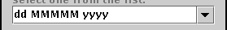
JComboBox
public JComboBox()
public JComboBox(Vector items)
public JComboBox(ComboBoxModel model)
Constructs a combo box. Can optionally pass a vector or model of items. (See DefaultComboBoxModel for a model implementation.)
public void addActionListener(
ActionListener al)
Causes an action event to be sent to listener al when the user selects or types a new item in the combo box.

Slide 29
JComboBox: Managing Items
public void addItem(Object item)
public Object getItemAt(int index)
public void removeAllItems()
public void removeItem(Object item)
public void removeItemAt(int index)

Slide 30
JComboBox: Selected Item
public int getSelectedIndex()
public Object getSelectedItem()
public void setSelectedItem(Object item)
public void setSelectedIndex(int index)
public void setEnabled(boolean enabled)
public void setEditable(boolean editable)
If editable, the user can type new arbitrary values into the combo box.

Slide 31
JComboBox Code Example
final JComboBox box = new JComboBox();
box.addItem("Marty"); box.addItem("Tom");
box.addItem("Jessica");
box.addActionListener(new ActionListener() {
public void actionPerformed(ActionEvent event) {
JOptionPane.showMessageDialog(null,
"You chose " + box.getSelectedItem());
}
});
getContentPane().add(box, BorderLayout.NORTH);

Slide 32
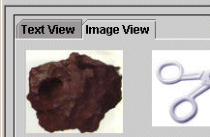
JTabbedPane
A container that can hold many "tab"
subcontainers, each with components in it
public JTabbedPane()
public JTabbedPane(int tabAlignment)
Constructs a new tabbed pane. Defaults to having the tabs on top; can be set to JTabbedPane.BOTTOM, LEFT, RIGHT, etc.
public void addTab(String title, Component comp)
public void addTab(String title, Icon icon,
Component comp)
public void addTab(String title, Icon icon,
Component comp, String tooltip)
Adds the given component as a tab in this tabbed pane. Can optionally use an icon and/or tool tip.

Slide 33
JTabbedPane methods
public void insertTab(String title,
Icon icon, Component comp,
String tooltip, int index)
public void remove(Component comp)
public void remove(int index)
public void removeAll()
public void setSelectedComponent(Component c)
public void setSelectedIndex(int index)

Slide 34
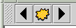
JToolBar
A movable container to hold
common buttons, commands, etc
public JToolBar()
public JToolBar(int orientation)
public JToolBar(String title)
public JToolBar(String title, int orientation)
Constructs a new tool bar, optionally with a title and orientation; can be JToolBar.HORIZONTAL or VERTICAL, defaults to horizontal
public void add(Component comp)
Adds the given component to this tool bar's horizontal/vertical flowing layout.

Slide 35
JToolBar: Usage
construct toolbar
add items (usually buttons) to toolbar
add toolbar to edge of BorderLayout of content pane (usually NORTH)
  don't put anything in other edges (N/S/E/W)!

Slide 36

JList
A list of selectable
pre-defined items
public JList()
Constructs an empty JList.
public JList(ListModel model)
public JList(Object[] data)
public JList(Vector data)
Constructs a JList that displays the given data.
public void addListSelectionListener(
ListSelectionListener lsl)
Adds the given listener to be informed when the selected index / indices change for this list.

Slide 37
JList: more methods
public void clearSelection()
public int getSelectedIndex()
public int[] getSelectedIndices()
public Object getSelectedValue()
public Object[] getSelectedValues()
public void setSelectedIndex(int index)
public void setSelectedIndices(int[] indices)
Methods for getting / setting the selected item and index in the list.

Slide 38
JList: even more methods
public ListModel getModel()
public void setListData(Object[] data)
public void setListData(Vector data)
public void setModel(ListModel model)
Causes this list to now display the given collection of data.
public int getSelectionMode()
public void setSelectionMode(int mode)
Get / set selection mode for the list. For example, set
to ListSelectionModel.SINGLE_SELECTION to only allow one item in the list to be chosen at once.

Slide 39
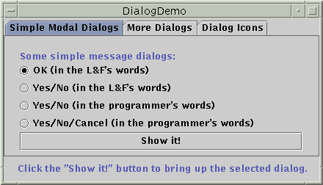
JDialog
A window that is a child of the
overall JFrame; used for popup
windows, option/config boxes, etc.
public JDialog(Dialog parent, boolean modal)
public JDialog(Frame parent, String title,
boolean modal)
Constructs a new dialog with the given parent and title. If the modal flag is set, this dialog is a child of the parent and the parent will be locked until the dialog is closed.
public void show()
Shows this dialog on screen. If the dialog is modal, calling show() will lock the parent frame/dialog.
JDialog has most all JFrame methods: getContentPane(), setJMenuBar(JMenuBar), setResizable(boolean), setTitle(String), ...

Slide 40
Problem: positioning, resizing
How does the programmer specify where each component sits in the window, how big each component should be, and what the component should do if the window is resized/moved/maximized/etc?
Absolute positioning (C++, C#, others):
Specify exact pixel coordinates for every component
Layout managers (Java):
Have special objects that decide where to position each component based on some criteria
  What are benefits or drawbacks to each approach?

Slide 41
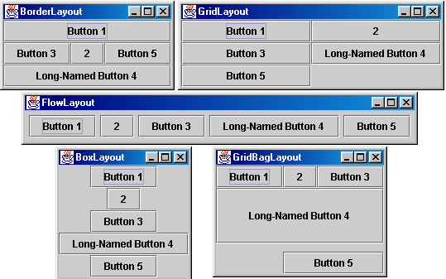
Containers with layout
The idea: Place many components into a special component called a container, then add the container to the JFrame

Slide 42
Container
container: an object that holds components; it also governs their positions, sizes, and resize behavior
public void add(Component comp)
public void add(Component comp, Object info)
Adds a component to the container, possibly giving extra information about where to place it.
public void remove(Component comp)
Removes the given component from the container.
public void setLayout(LayoutManager mgr)
Uses the given layout manager to position the components in the container.
public void validate()
You should call this if you change the contents of a container that is already on the screen, to make it re-do its layout.

Slide 43
JPanel
A panel is our container of choice; it is a subclass of Container, so it inherits the methods from the previous slide and defines these additional methods (among others):
public JPanel()
Constructs a panel with a default flow layout.
public JPanel(LayoutManager mgr)
Constructs a panel that uses the given
layout manager.

Slide 44

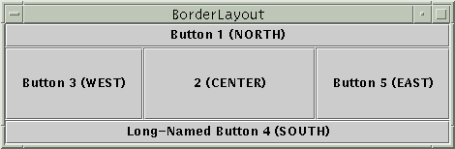
Preferred size of components
Swing component objects each have a certain size they would "like" to be--just large enough to fit their contents (text, icons, etc.)
This is called the preferred size of the component
Some types of layout managers (e.g. FlowLayout) choose to size the components inside them to the preferred size; others (e.g. BorderLayout, GridLayout) disregard the preferred size and use some other scheme
Buttons at preferred size: Not preferred size:

Slide 45
BorderLayout
public BorderLayout()
divides container into five regions: NORTH, SOUTH, WEST, EAST, CENTER
NORTH and SOUTH regions expand to fill region horizontally, and use preferred size vertically
WEST and EAST regions expand to fill region vertically, and use preferred size horizontally
CENTER uses all space not occupied by others
Container panel = new JPanel(new BorderLayout());
panel.add(new JButton("Button 1 (NORTH)", BorderLayout.NORTH);

Slide 46
FlowLayout
public FlowLayout()
treats container as a left-to-right, top-to-bottom "page" or "paragraph"
components are given their preferred size both horizontally and vertically
components are positioned in order added
if too long, components wrap around to next line
Container panel = new JPanel(new FlowLayout());
panel.add(new JButton("Button 1"));

Slide 47
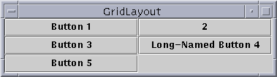
GridLayout
public GridLayout(int rows, int columns)
treats container as a grid of equally-sized rows and columns
components are given equal horizontal / vertical size, disregarding preferred size
can specify 0 rows or columns to indicate expansion in that direction as needed

Slide 48
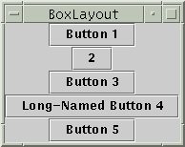
BoxLayout
Box.createHorizontalBox()
Box.createVerticalBox()
aligns components in container in a single row or column
components use preferred sizes and align based on their preferred alignment
preferred way to construct a container with box layout:
Box.createHorizontalBox(); or Box.createVerticalBox();

Slide 49

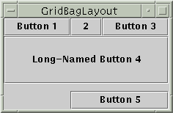
Other layouts
CardLayout
layers of "cards" stacked
on top of each other;
one visible at a time
GridBagLayout
very complicated;
my recommendation:
never ever use it
custom / null layout
allows you to define absolute positions using setX/Y and setWidth/Height

Slide 50
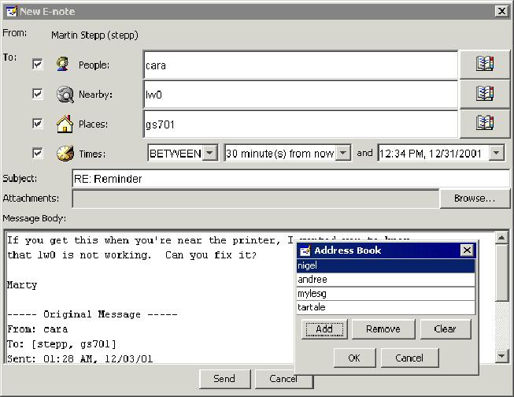
Problem with layout managers
How would you create a complex window like this, using the layout managers shown?

Slide 51
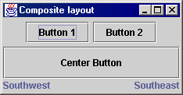
Solution: composite layout
create panels within panels
each panel has a different layout, and by combining the layouts, more complex / powerful layout can be achieved
example:
  how many panels?
  what layout in each?

Slide 52
Some eye candy...
making a Java Swing GUI look like the native operating system:
    try {
    UIManager.setLookAndFeel(
    UIManager.getSystemLookAndFeelClassName());
    } catch Exception e) {}
adding borders to components:
    whateverComponent.setBorder(
    BorderFactory.createLineBorder(Color.BLUE, 3));

Slide 53
GUI is not done yet...
What is missing?
  Why don't the buttons do anything when we click them?
  How can we fix this problem?
Next topic: events
  (making the GUI responsive to user interaction)
  allows our own GUIs to be interactive like JOptionPane

Slide 54
Event-driven Programming
program's execution is indeterminate
on-screen components cause events to occur when they are clicked / interacted with
events can be handled, causing the program to respond, driving the execution thru events (an "event-driven" program)

Slide 55
Java Event Hierarchy
java.lang.Object
+--java.util.EventObject
+--java.awt.AWTEvent
+--java.awt.event.ActionEvent
+--java.awt.event.TextEvent
+--java.awt.event.ComponentEvent
+--java.awt.event.FocusEvent
+--java.awt.event.WindowEvent
+--java.awt.event.InputEvent
+--java.awt.event.KeyEvent
+--java.awt.event.MouseEvent
import java.awt.event.*;

Slide 56
Action events (ActionEvent)
most common / simple event type in Swing
represent an action occurring on a GUI component
created by:
  button clicks
  check box checking / unchecking
  menu clicks
  pressing Enter in a text field
  etc.

Slide 57

Listening for events
attach listener to component
listener’s appropriate method will be called when event occurs (e.g. when the button is clicked)
for Action events, use ActionListener

Slide 58
Writing an ActionListener
// part of Java; you don’t write this
public interface ActionListener {
public void actionPerformed(ActionEvent event);
}
// Prints a message when the button is clicked.
public class MyActionListener
implements ActionListener {
public void actionPerformed(ActionEvent event){
System.out.println("Event occurred!");
}
}

Slide 59
Attaching an ActionListener
JButton button = new JButton("button 1");
ActionListener listener = new MyActionListener();
button.addActionListener(listener);
now button will print "Event occurred!" when clicked
addActionListener method exists in many Swing components

Slide 60
ActionEvent objects
public Object getSource()
Returns object that caused this event to occur.
public String getActionCommand()
Returns a string that represents this event.
(for example, text on button that was clicked)
Question: Where to put the listener class?

Slide 61
Inner class listener
public class Outer {
private class Inner implements ActionListener {
public void actionPerformed(
ActionEvent event) {
...
}
}
public Outer() {
JButton myButton = new JButton();
myButton.addActionListener(new Inner());
}
}

Slide 62
Anonymous inner listener
public class Outer {
public Outer() {
JButton myButton = new JButton();
myButton.addActionListener(
new ActionListener() {
public void actionPerformed(ActionEvent e) {
...
}
}
);
}
}

Slide 63
ActionListener in JFrame
public class Outer extends JFrame
implements ActionListener {
public Outer() {
JButton myButton = new JButton();
myButton.addActionListener(this);
}
public void actionPerformed(ActionEvent event) {
...
}
}

Slide 64
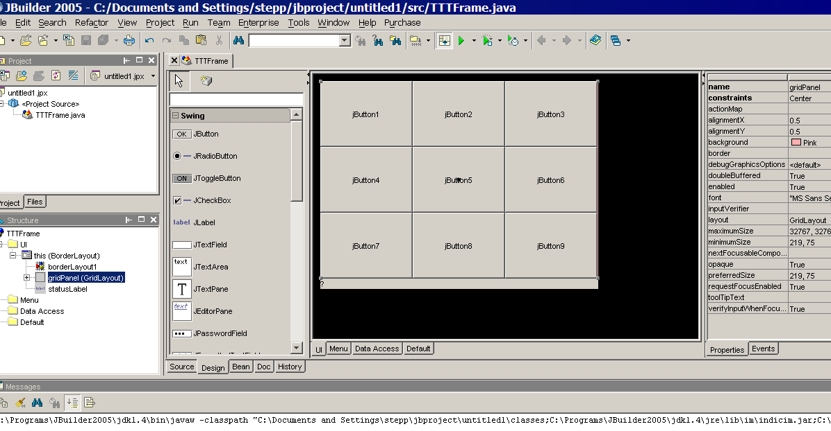
GUI builder software
JBuilder 2005 includes a mature GUI builder
  http://www.borland.com/jbuilder/

Slide 65
Reminder: model and view
model: classes in your system that are related to the internal representation of the state of the system
  often part of the model is connected to file(s) or database(s)
  examples (card game): Card, Deck, Player
  examples (bank system): Account, User, UserList
view: classes in your system that display the state of the model to the user
  generally, this is your GUI (could also be a text UI)
  should not contain crucial application data
  Different views can represent the same data in different ways
    Example: Bar chart vs. pie chart
  examples: PokerPanel, BankApplet

Slide 66
Model-view-controller
model-view-controller (MVC): common design paradigm for graphical systems
controller: classes that connect model and view
  defines how user interface reacts to user input (events)
  receives messages from view (where events come from)
  sends messages to model (tells what data to display)
  sometimes part of view (see left)
data for rendering
Model
View
View
Component
Model
updates
events
Controller
Controller

Slide 67
Observer pattern
observer: an object that "watches" the state of another object and takes action when the state changes in some way
observable object: an object that allows observers to examine it (often the observable object notifies the observers when it changes)
permits customizable, extensible event-based behavior for data modeling and graphics
examples in Java: event listeners; java.util.Observer

Slide 68
Benefits of observer
abstract coupling between subject and observer; each can be extended and reused individually
dynamic relationship between subject and observer; can be established at run time (can "hot-swap" views, etc) gives a lot more programming flexibility
broadcast communication: notification is broadcast automatically to all interested objects that subscribed to it
Observer can be used to implement model-view separation in Java more easily

Slide 69
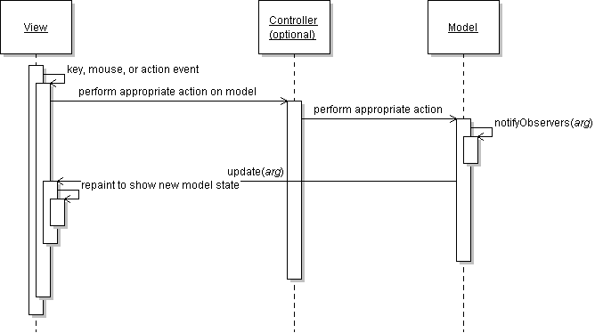
Observer sequence diagram

Slide 70
Observer interface
package java.util;
public interface Observer {
public void update(Observable o, Object arg);
}
Idea: The update method will be called when the observable model changes, so put the appropriate code to handle the change inside update

Slide 71
Observable class
public void addObserver(Observer o)
public void deleteObserver(Observer o)
Adds/removes o to/from the list of objects that will be notified (via their update method) when notifyObservers is called.
public void notifyObservers()
public void notifyObservers(Object arg)
Inform all observers listening to this Observable object of an event that has occurred. An optional object argument may be passed to provide more information about the event.
public void setChanged()
Flags the observable object as having changed since the last event; must be called each time before calling notifyObservers.

Slide 72
Common usage of Observer
write a model class that extends Observable
have the model notify its observers when anything significant happens
make all views of that model (e.g. GUI panels that draw the model on screen) into observers
have the panels take action when the model notifies them of events (e.g. repaint, play sound, show option dialog, etc.)

Slide 73
Using multiple views
make an Observable model
write an abstract View superclass which is a JPanel container
  make View an observer
extend View for all actual views
  give each its own unique inner components and code to draw the model's state in its own way
provide mechanism in GUI to set view (perhaps through menus)
  to set view, attach it to observe the model

Slide 74
Example: changing views
// in the frame's action listener:
// hide old view; show new one
this.model.deleteObserver(this.view1);
this.model.addObserver(this.view2);
this.view1.setVisible(false);
this.view2.setVisible(true);

Slide 75
References
The Java Tutorial: Visual Index to the Swing Components.
http://java.sun.com/docs/books/tutorial/
uiswing/components/components.html
The Java Tutorial: Laying Out Components Within a Container.
http://java.sun.com/docs/books/tutorial/uiswing/
layout/index.html
The Java Tutorial: How to Write Action Listeners.
http://java.sun.com/docs/books/tutorial/
uiswing/events/actionlistener.html
Java Class Library Reference: Observer, Observable.
http://java.sun.com/j2se/1.4.2/docs/api/java/util/Observer.html
http://java.sun.com/j2se/1.4.2/docs/api/java/util/Observable.html

